Slide 1
BIG MOUNTAIN RESORT
Which types/quality of snow park attractions/additional facilities are sufficiently appealing to support a chairlift ticket price by $4.4
By Maryam Israfilova

Slide 2
Contents
Problem Identification
Recommendation and key findings
Modeling Results and Analysis
Summary and Conclusions

Slide 3
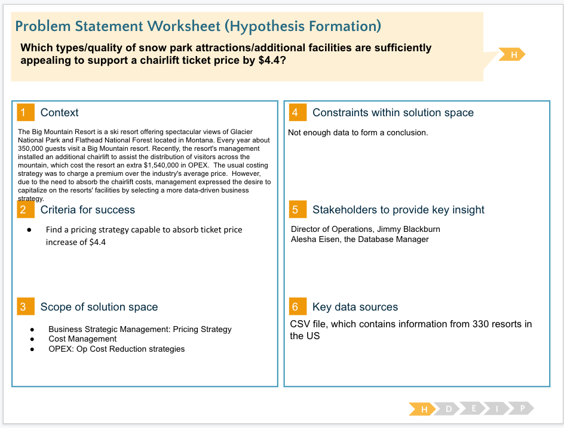
Problem

Slide 4
Recommendations and key findings
Current Pricing Model:
Per ticket price: $ 81
Based on industry average plus premium
Pros: Easy to calculate
Cons: Prone to significant undercapitalization and loss of opportunity income.
Suggested Pricing Model:
Per ticket price: $ 91.80
Developed using a statistical modeling using dependencies between ticket price and resort’s amenities reflecting ticket buying preferences of the customers.
Pros: Helps to ensure that no pricing opportunities are lost as well as define if there are any non-value adding amenities that could be potentially discontinued.
Cons: requires special skills and expertise to develop

Slide 5
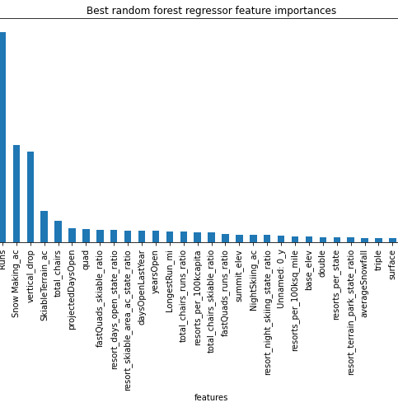
Modeling results and analysis
Key Features:
Fast Quads
Runs
Snow Making
Vertical Drop
Skiable Terrain
Total Chairs
Notes:
Consider talking about:
Trail ratings

Slide 6
Modeling results and analysis
Scenario 2: Add a run, increase the vertical drop by 150 feet, and install an additional chair lift.
Result: This scenario increases support for ticket price by $0.68. Over the season, this could be expected to amount to $1,181,250
Scenario 3: Add a run, increase the vertical drop by 150 feet, and install an additional chair lift, add 2 acres of snowmaking
Result: This scenario increases support for ticket price by $0.68. Over the season, this could be expected to amount to $1,181,250.
Scenario 4: Increase the longest run by 0.2 miles with additional snowmaking
Result: Our Model has predicted an increase of 0.011, which effectively does not affect our data.
Scenario 1: close-up to 10 of the least used runs
Result: Model has shown that closing one run makes no difference. Consequentially, the closure of 2 and 3 successively reduces support for ticket price and so revenue. If Big Mountain shuts down three runs, it seems they may as well close 4 or 5 as there's no further loss in the ticket price. They are increasing the closures down to 6 or more leads to a significant drop.
Notes:
Consider talking about:
Trail ratings

Slide 7
Summary and conclusion
New Pricing Model based on Scenario 2
Increasing support for ticket price by $0.68
Increase in seasonal revenue by $1,181,250
Higher return on investment
Additional Considerations/Need for Further Analysis:
each Model should be evaluated in terms of expected return on investment
additional costing information of the "new chair lift," plus investment costs for each extra feature, such as the cost of increasing the vertical drop by 150 ft or price of 4 additional acres of snow capability addition, would be necessary to complete the analysis
Notes:
Consider talking about:
Trail ratings

